Slide 1
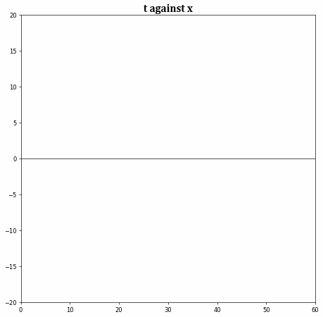
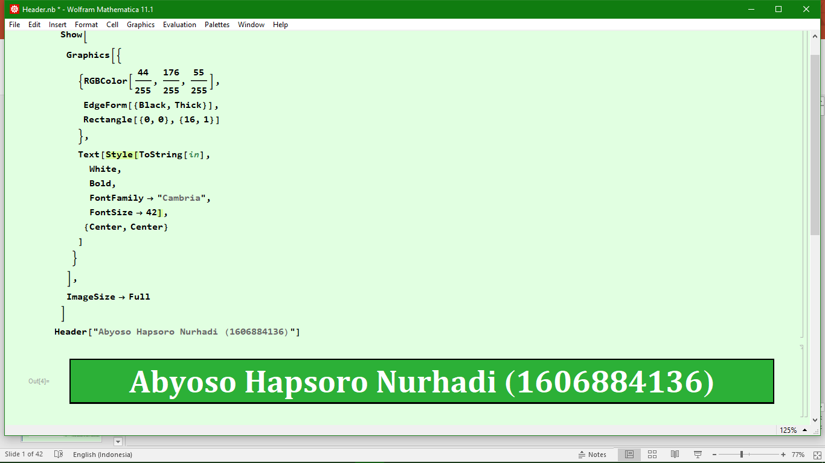
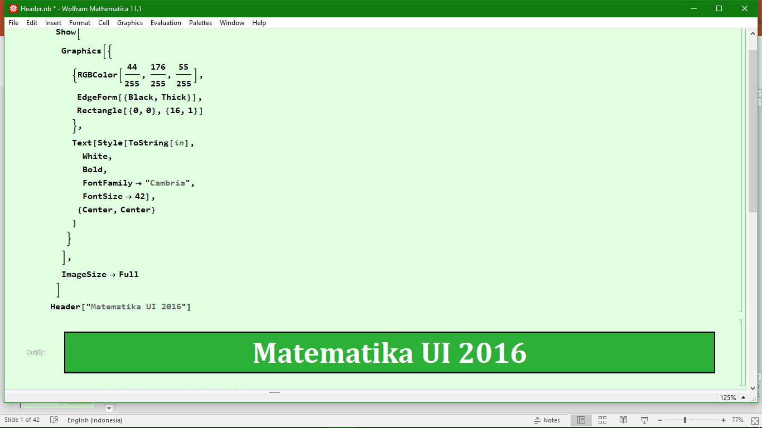
Chaos and Strange Attractors: The Lorenz Equations

Slide 2
Outline
Introduction to the Lorenz Equation
Jacobian of the Lorenz Equation
Lorenz Equation
on Earth
The Lorenz Equation
Critical Points of the Lorenz Equation
Plot of the
Lorenz Equation

Slide 3
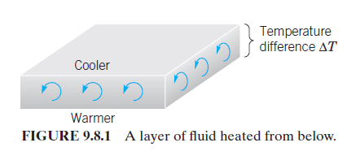
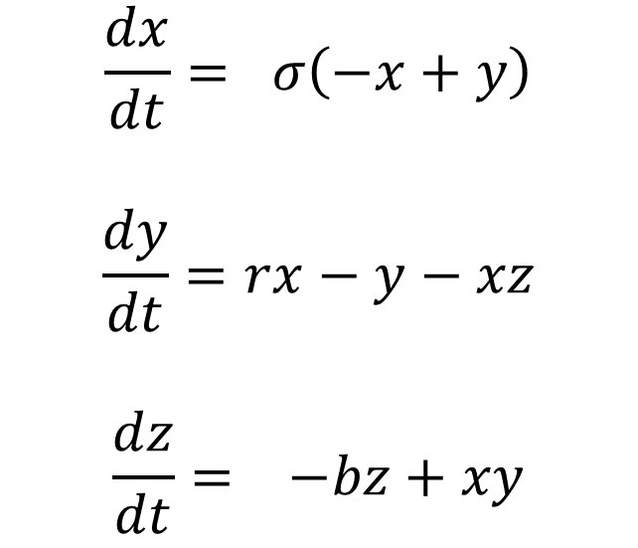
Introduction to Lorenz Equation
$$\frac{dx}{dt}= σ\left(−x+y\right)$$
$$\frac{dy}{dt}=rx−y−xz$$
$$\frac{dz}{dt}= −bz+xy$$

Slide 4
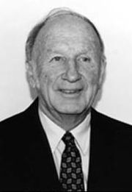
Introduction to Lorenz Equation
Edward Norton Lorenz
Father of Chaos Theory and Butterfly Effect

Slide 5
Introduction to Lorenz Equation
Lorenz System
Fourier-Galerkin
Expansion
Oberbeck-Boussinesq
Approximation
The original problem was a 2D problem considering the thermal convection between two parallel horizontal plates
Navier-Stokes
Equation
Thermal
Convection

Slide 6
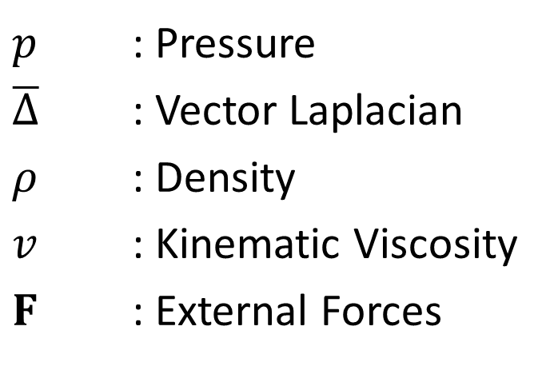
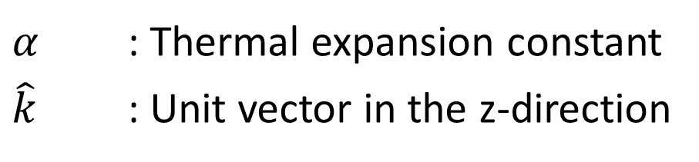
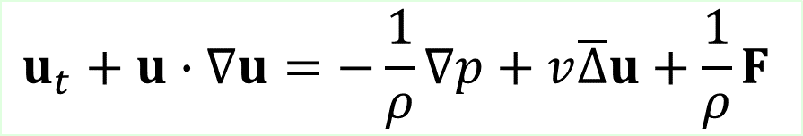

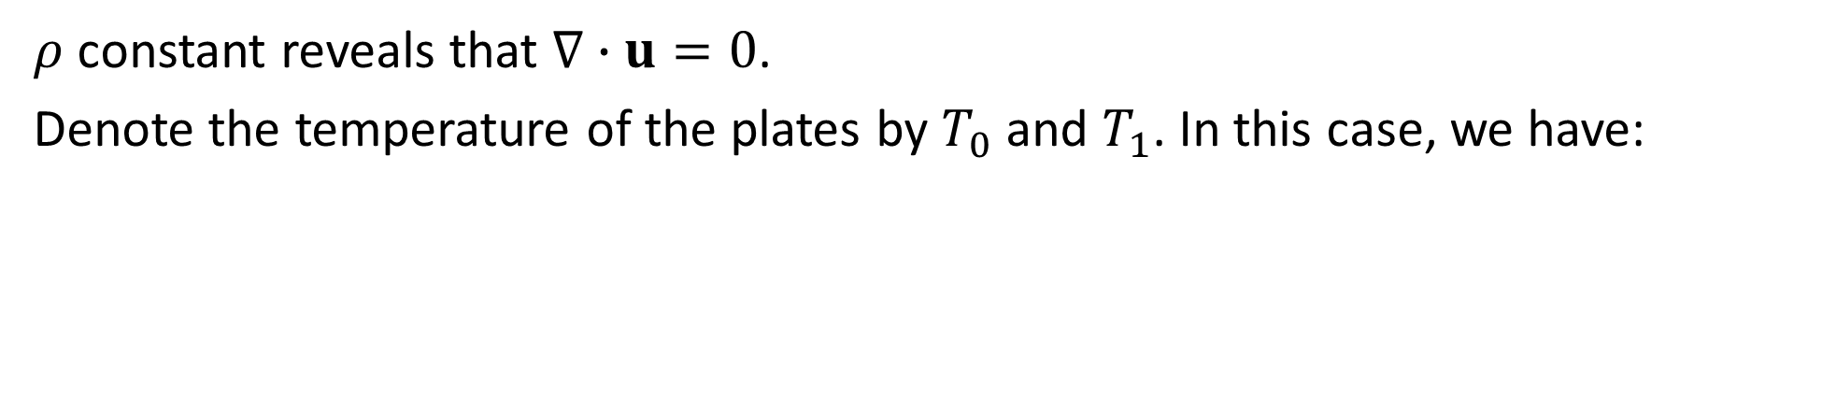

Introduction to Lorenz Equation
Momentum
$$u_{t}+u∙∇u=−\frac{1}{ρ}∇p+v\overline{Δ}u+\frac{1}{ρ}F$$
$p$ : Pressure
$\overline{Δ}$ : Vector Laplacian
$ρ$ : Density
$v$ : Kinematic Viscosity
$F$ : External Forces
Continuity
$$ρ_{t}+∇∙\left(ρu\right)=0$$
$ρ$ constant reveals that $∇∙u=0$.
Denote the temperature of the plates by $T_{0}$ and $T_{1}$. In this case, we have:
$$F=αg\left(T−T_{0}\right)\hat{k}$$
$α$ : Thermal expansion constant
$\hat{k}$ : Unit vector in the z-direction

Slide 7
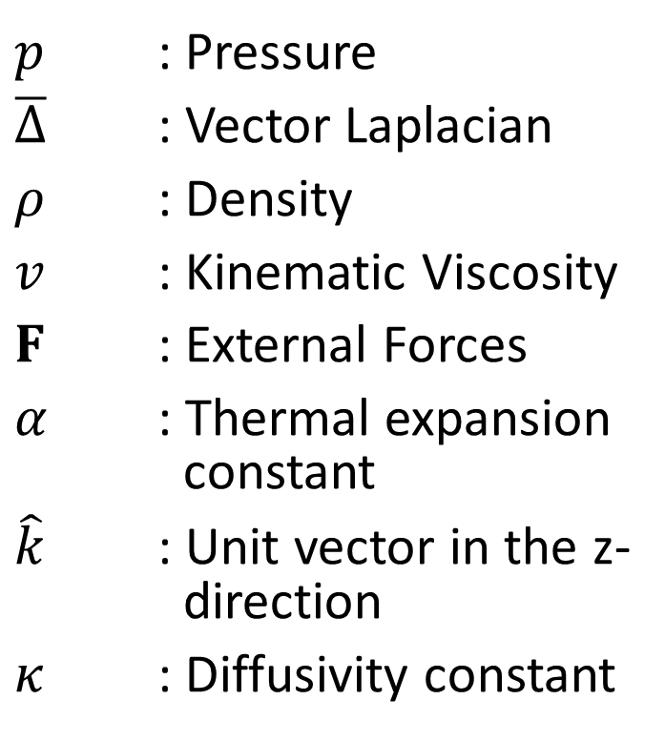



Introduction to Lorenz Equation
Momentum
$$u_{t}+u∙∇u=−\frac{1}{ρ}∇p+v\overline{Δ}u+\frac{1}{ρ}F$$
$p$ : Pressure
$\overline{Δ}$ : Vector Laplacian
$ρ$ : Density
$v$ : Kinematic Viscosity
$F$ : External Forces
$α$ : Thermal expansion constant
$\hat{k}$ : Unit vector in the z- direction
$κ$ : Diffusivity constant
Continuity
$$ρ_{t}+∇∙\left(ρu\right)=0$$
Force
$$F=αg\left(T−T_{0}\right)\hat{k}$$
Temperature
$$T_{t}+u∙∇T=κΔT$$

Slide 8
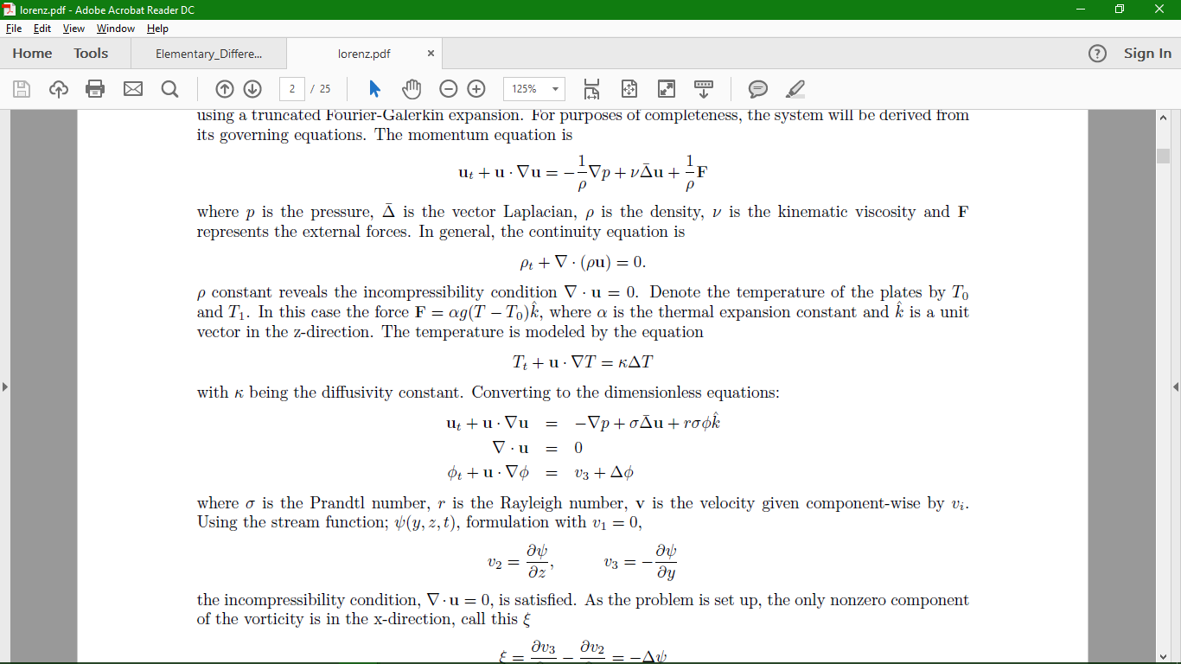
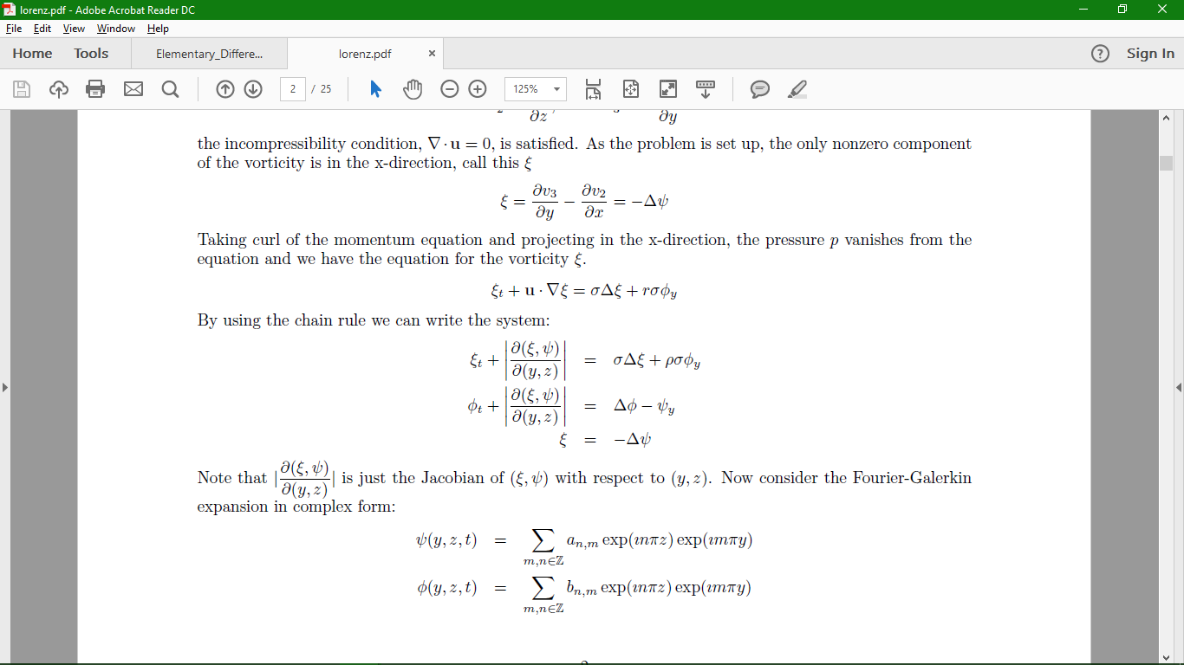
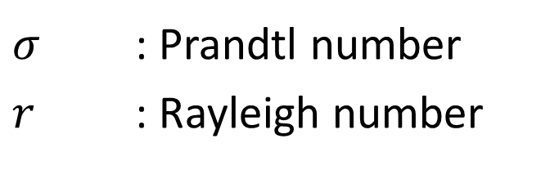
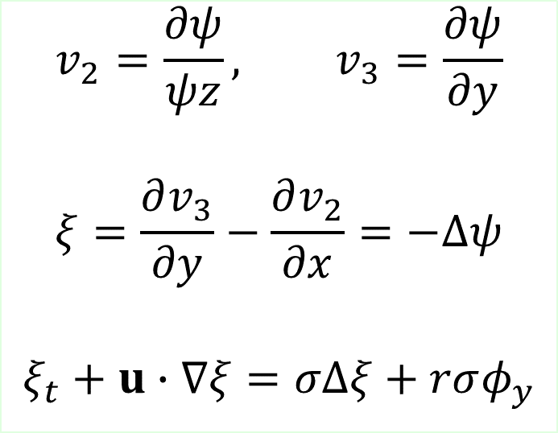
Introduction to Lorenz Equation
$σ$ : Prandtl number
$r$ : Rayleigh number
$$v_{2}=\frac{∂ψ}{ψz}, v_{3}=\frac{∂ψ}{∂y}$$
$$ξ=\frac{∂v_{3}}{∂y}−\frac{∂v_{2}}{∂x}=−Δψ$$
$$ξ_{t}+u∙∇ξ=σΔξ+rσφ_{y}$$

Slide 9
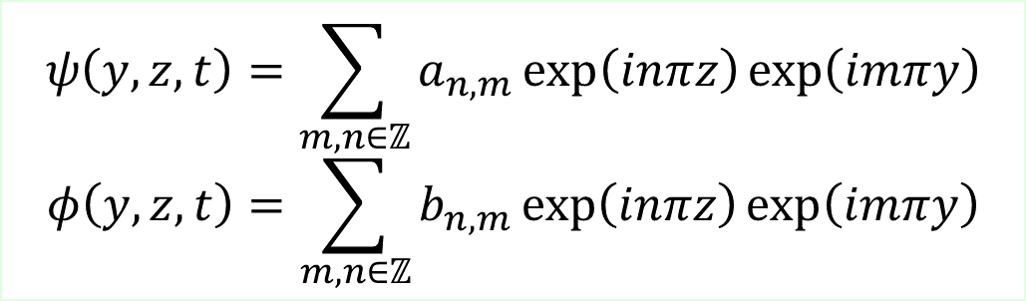
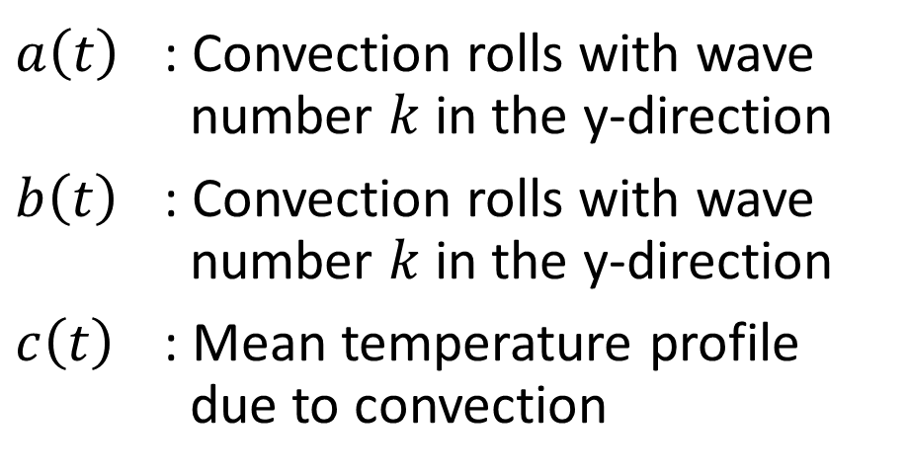
Introduction to Lorenz Equation
Fourier Galerkin
$$ψ\left(y,z,t\right)=\sum_{m,n∈ℤ}{a_{n,m}\exp\left(inπz\right)\exp\left(imπy\right)}$$
$$φ\left(y,z,t\right)=\sum_{m,n∈ℤ}{b_{n,m}\exp\left(inπz\right)\exp\left(imπy\right)}$$
$a\left(t\right)$ : Convection rolls with wave number $k$ in the y-direction
$b\left(t\right)$ : Convection rolls with wave number $k$ in the y-direction
$c\left(t\right)$ : Mean temperature profile due to convection
$$ψ\left(y,z,t\right)=a\left(t\right)\sin\left(πz\right)\sin\left(kπy\right)$$
$$φ\left(y,z,t\right)=b\left(t\right)\sin\left(πz\right)\cos\left(kπy\right)+c\left(t\right)\sin\left(2πz\right)$$

Slide 10
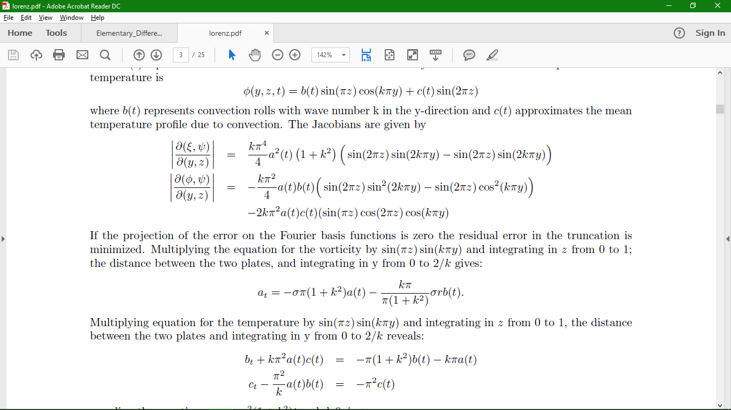
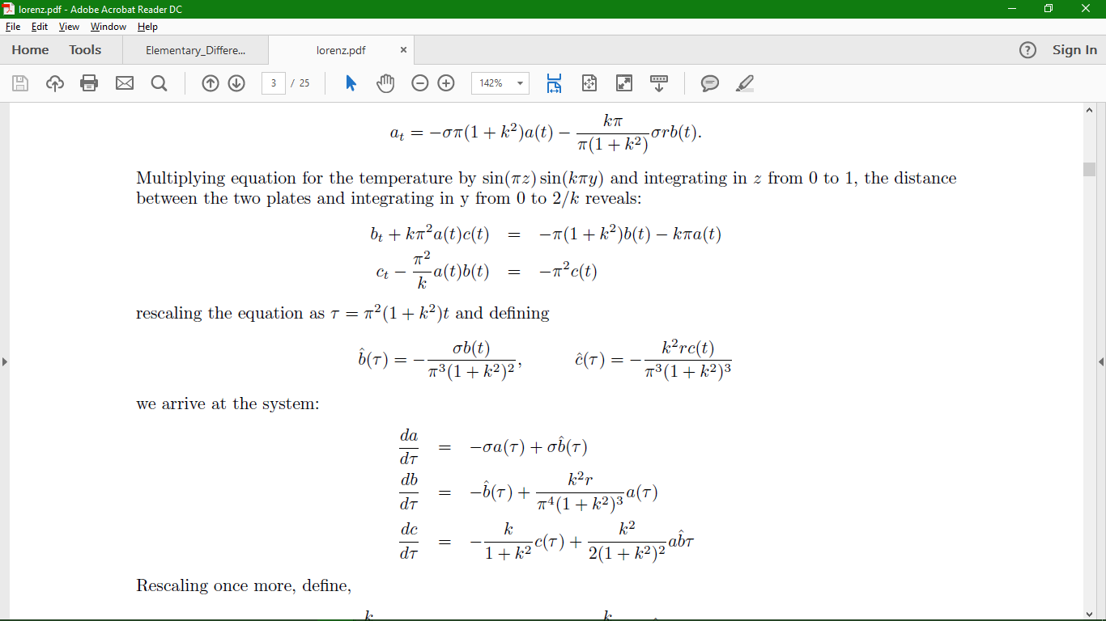
Introduction to Lorenz Equation

Slide 11
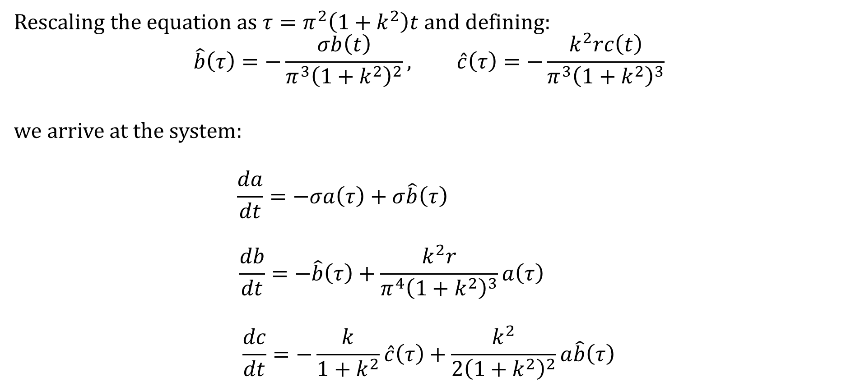
Introduction to Lorenz Equation
Rescaling the equation as $τ=π^{2}\left(1+k^{2}\right)t$ and defining:
$$\hat{b}\left(τ\right)=−\frac{σb\left(t\right)}{π^{3}{\left(1+k^{2}\right)}^{2}}, \hat{c}\left(τ\right)=−\frac{k^{2}rc\left(t\right)}{π^{3}{\left(1+k^{2}\right)}^{3}}$$
we arrive at the system:
$$\frac{da}{dt}=−σa\left(τ\right)+σ\hat{b}\left(τ\right)$$
$$\frac{db}{dt}=−\hat{b}\left(τ\right)+\frac{k^{2}r}{π^{4}{\left(1+k^{2}\right)}^{3}}a\left(τ\right)$$
$$\frac{dc}{dt}=−\frac{k}{1+k^{2}}\hat{c}\left(τ\right)+\frac{k^{2}}{2{\left(1+k^{2}\right)}^{2}}a\hat{b}\left(τ\right)$$

Slide 12
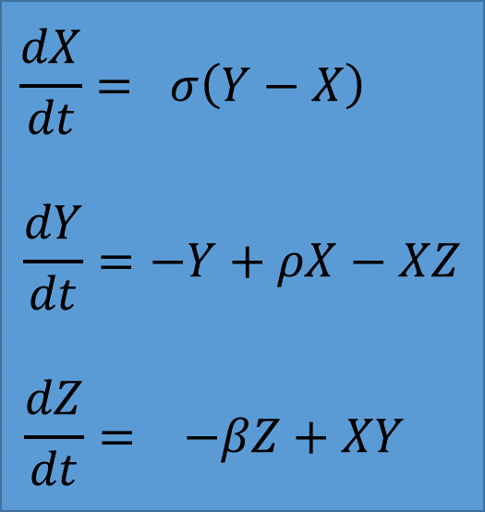
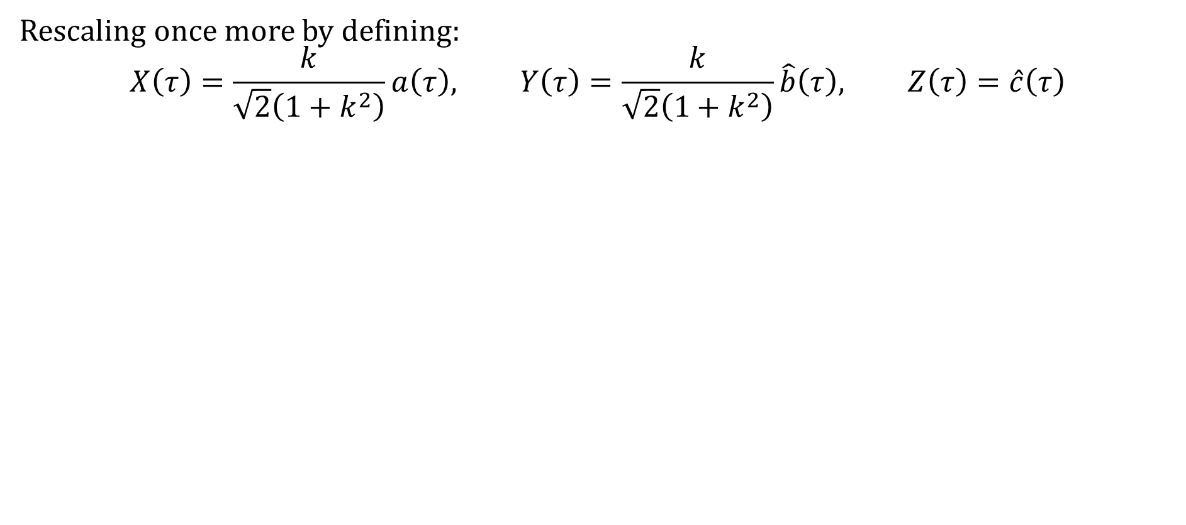
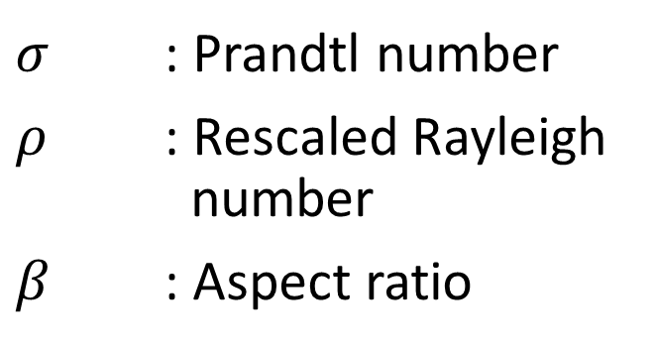
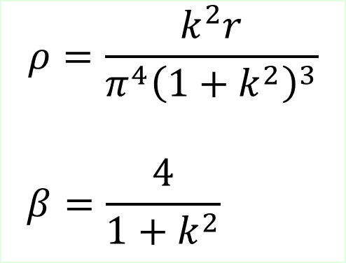
Introduction to Lorenz Equation
Rescaling once more by defining:
$$X\left(τ\right)=\frac{k}{\sqrt{2}\left(1+k^{2}\right)}a\left(τ\right), Y\left(τ\right)=\frac{k}{\sqrt{2}\left(1+k^{2}\right)}\hat{b}\left(τ\right), Z\left(τ\right)=\hat{c}\left(τ\right)$$
$$\frac{dX}{dt}= σ\left(Y−X\right)$$
$$\frac{dY}{dt}=−Y+ρX−XZ$$
$$\frac{dZ}{dt}= −βZ+XY$$
$$ρ=\frac{k^{2}r}{π^{4}{\left(1+k^{2}\right)}^{3}}$$
$$β=\frac{4}{1+k^{2}}$$
$σ$ : Prandtl number
$ρ$ : Rescaled Rayleigh number
$β$ : Aspect ratio

Slide 13
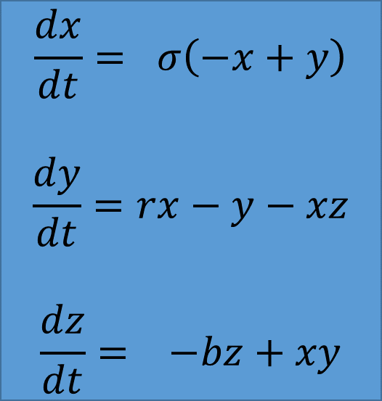
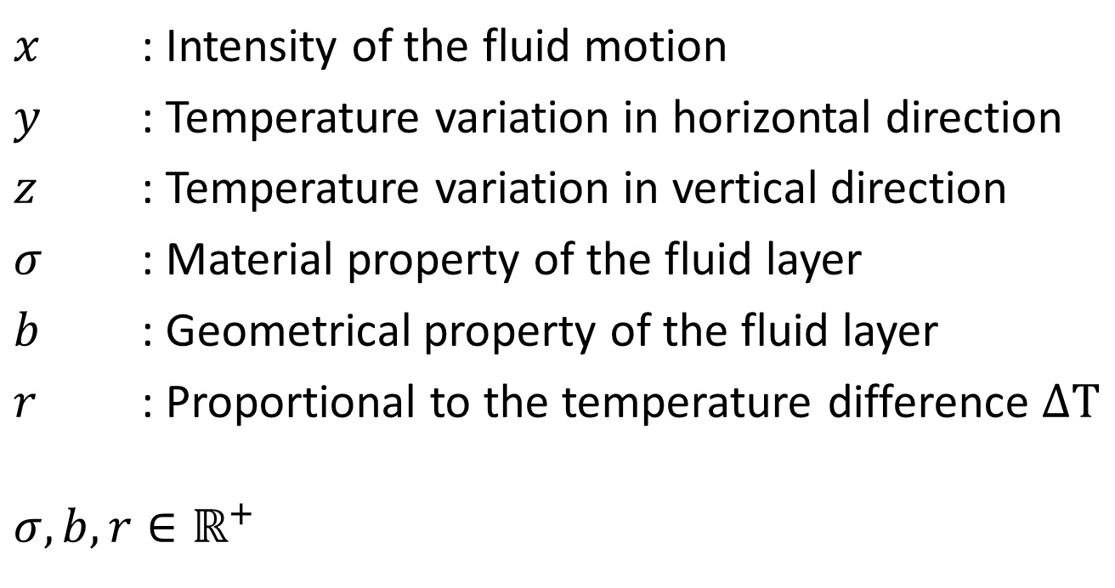
The Lorenz Equation
$$\frac{dx}{dt}= σ\left(−x+y\right)$$
$$\frac{dy}{dt}=rx−y−xz$$
$$\frac{dz}{dt}= −bz+xy$$
$x$ : Intensity of the fluid motion
$y$ : Temperature variation in horizontal direction
$z$ : Temperature variation in vertical direction
$σ$ : Material property of the fluid layer
$b$ : Geometrical property of the fluid layer
$r$ : Proportional to the temperature difference $ΔT$
$$σ,b,r∈ℝ^{+}$$

Slide 14
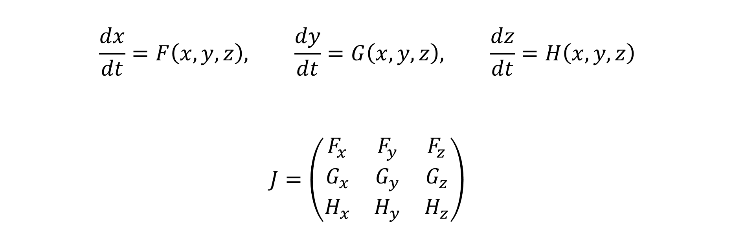
Jacobian of the Lorenz Equation
$$\frac{dx}{dt}=F\left(x,y,z\right), \frac{dy}{dt}=G\left(x,y,z\right), \frac{dz}{dt}=H\left(x,y,z\right)$$
$$J=\left(\begin{matrix}F_{x} & F_{y} & F_{z} \\ G_{x} & G_{y} & G_{z} \\ H_{x} & H_{y} & H_{z}\end{matrix}\right)$$

Slide 15
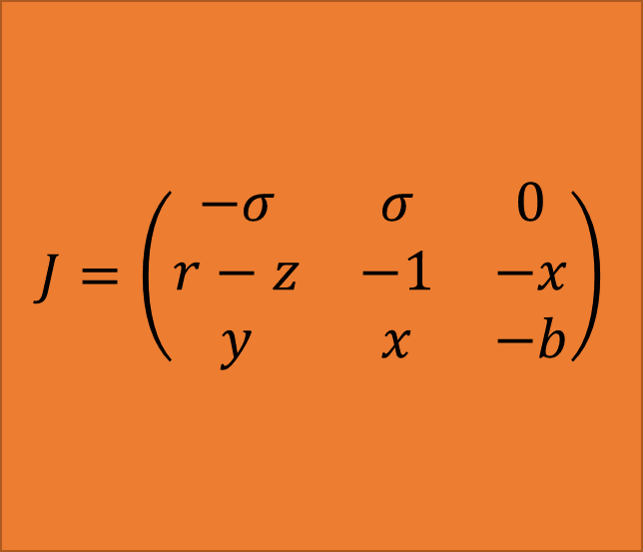
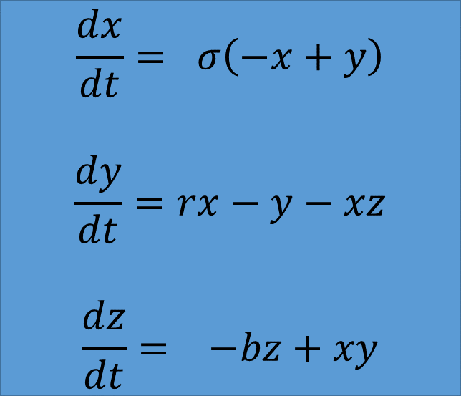
Jacobian of the Lorenz Equation
$$\frac{dx}{dt}= σ\left(−x+y\right)$$
$$\frac{dy}{dt}=rx−y−xz$$
$$\frac{dz}{dt}= −bz+xy$$
$$J=\left(\begin{matrix}−σ & σ & 0 \\ r−z & −1 & −x \\ y & x & −b\end{matrix}\right)$$

Slide 16
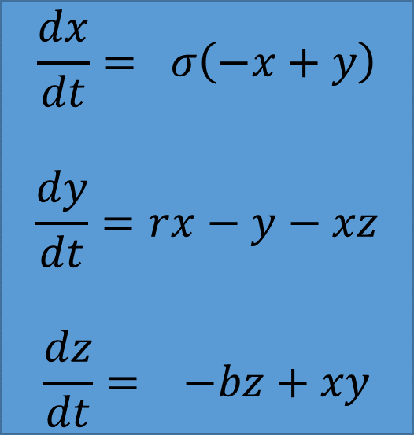
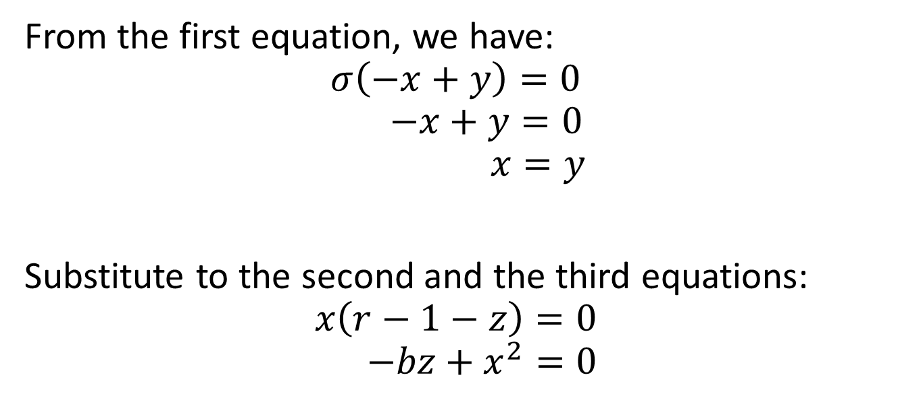
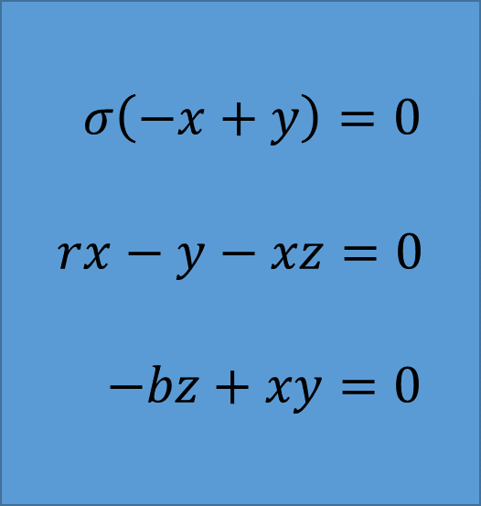
Critical Points of the Lorenz Equation
$$\frac{dx}{dt}= σ\left(−x+y\right)$$
$$\frac{dy}{dt}=rx−y−xz$$
$$\frac{dz}{dt}= −bz+xy$$
From the first equation, we have:
$$σ\left(−x+y\right)=0$$
$$−x+y=0$$
$$x=y$$
Substitute to the second and the third equations:
$$x\left(r−1−z\right)=0$$
$$−bz+x^{2}=0$$
$$σ\left(−x+y\right)=0$$
$$rx−y−xz=0$$
$$−bz+xy=0$$

Slide 17
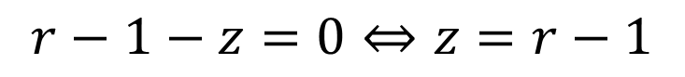
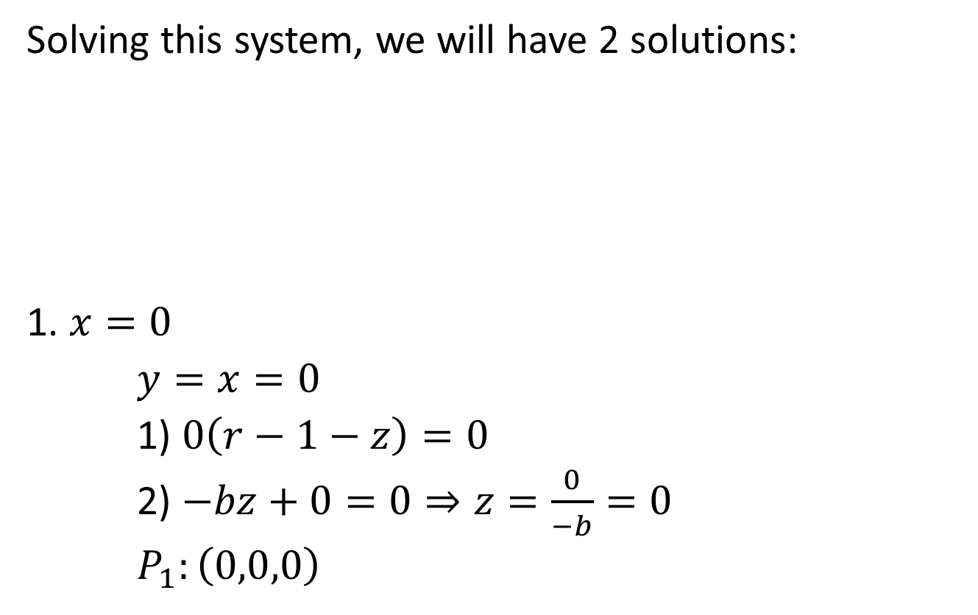
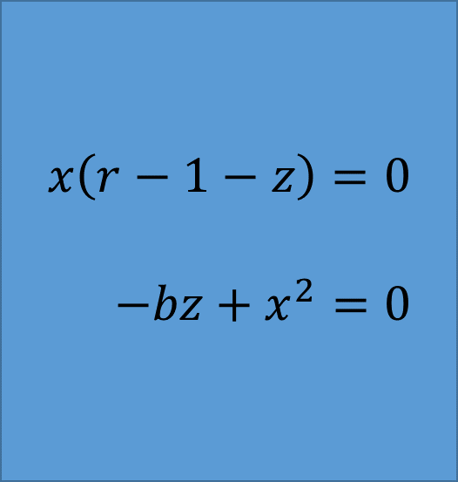
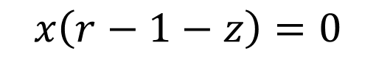
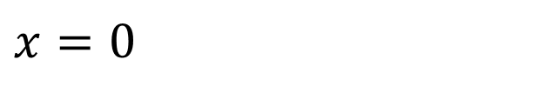
Critical Points of the Lorenz Equation
Solving this system, we will have 2 solutions:
1. $x=0$
$y=x=0$
1) $0\left(r−1−z\right)=0$
2) $−bz+0=0⇒z=\frac{0}{−b}=0$
$P_{1}:\left(0,0,0\right)$
$$x\left(r−1−z\right)=0$$
$$−bz+x^{2}=0$$
$$x=0$$
$$x\left(r−1−z\right)=0$$
$$r−1−z=0⇔z=r−1$$

Slide 18
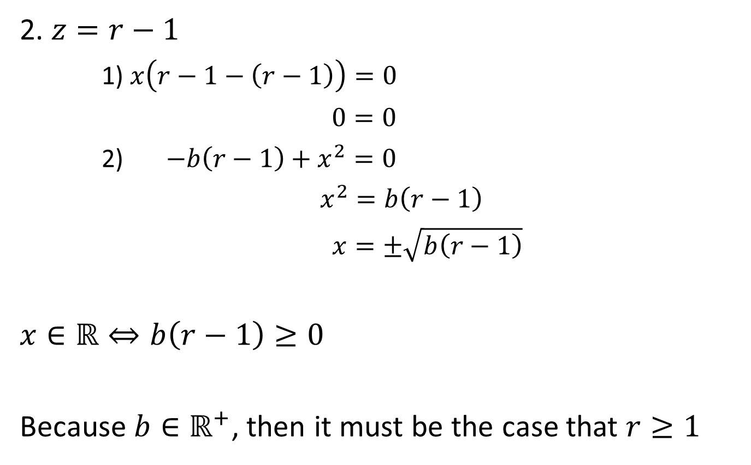
Critical Points of the Lorenz Equation
2. $z=r−1$
1) $x\left(r−1−\left(r−1\right)\right)=0$
$0=0$
2) $−b\left(r−1\right)+x^{2}=0$
$x^{2}=b\left(r−1\right)$
$x=±\sqrt{b\left(r−1\right)}$
$x∈ℝ⇔b\left(r−1\right)≥0$
Because $b∈ℝ^{+}$, then it must be the case that $r≥1$
$$x\left(r−1−z\right)=0$$
$$−bz+x^{2}=0$$

Slide 19
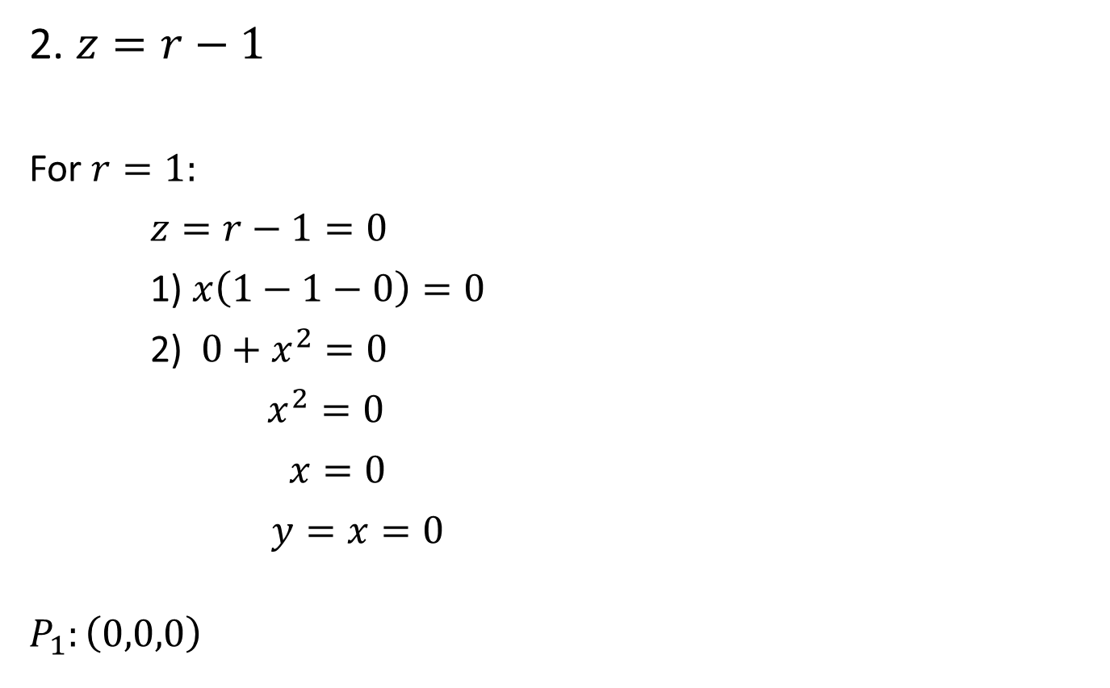
Critical Points of the Lorenz Equation
2. $z=r−1$
For $r=1:$
$z=r−1=0$
1) $x\left(1−1−0\right)=0$
2) $0+x^{2}=0$
$x^{2}=0$
$x=0$
$y=x=0$
$$P_{1}:\left(0,0,0\right)$$
$$x\left(r−1−z\right)=0$$
$$−bz+x^{2}=0$$

Slide 20
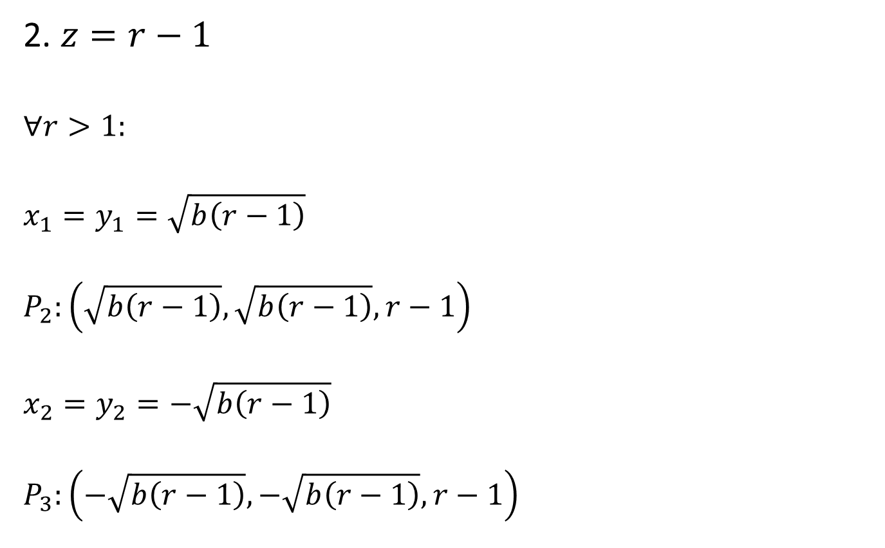
Critical Points of the Lorenz Equation
2. $z=r−1$
$$∀r>1:$$
$$x_{1}=y_{1}=\sqrt{b\left(r−1\right)}$$
$$P_{2}:\left(\sqrt{b\left(r−1\right)},\sqrt{b\left(r−1\right)},r−1\right)$$
$$x_{2}=y_{2}=−\sqrt{b\left(r−1\right)}$$
$$P_{3}:\left(−\sqrt{b\left(r−1\right)},−\sqrt{b\left(r−1\right)},r−1\right)$$
$$x\left(r−1−z\right)=0$$
$$−bz+x^{2}=0$$

Slide 21
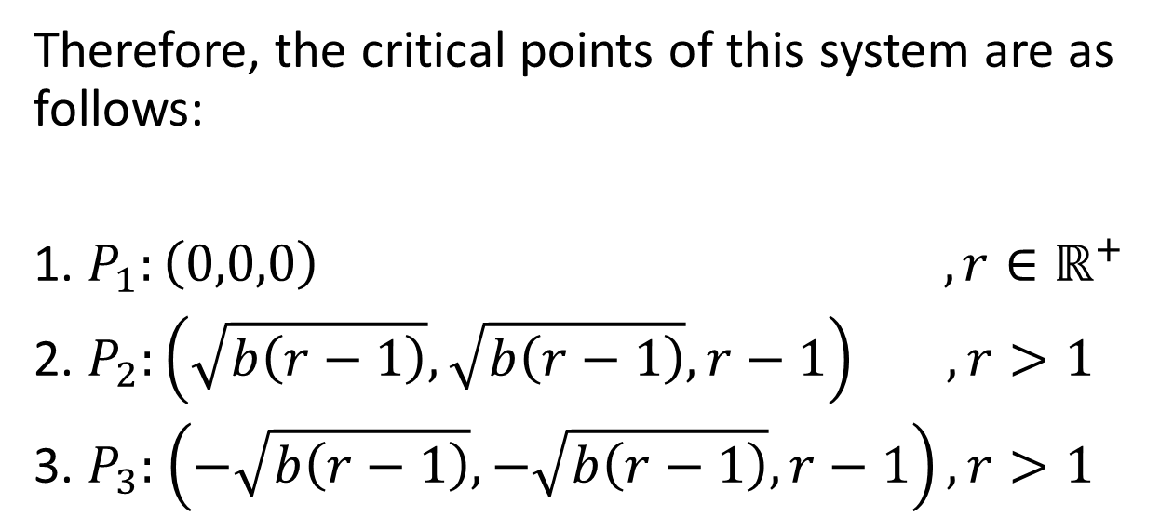
Critical Points of the Lorenz Equation
$$\frac{dx}{dt}= σ\left(−x+y\right)$$
$$\frac{dy}{dt}=rx−y−xz$$
$$\frac{dz}{dt}= −bz+xy$$
Therefore, the critical points of this system are as follows:
1. $P_{1}:\left(0,0,0\right)$ $,r∈ℝ^{+}$
2. $P_{2}:\left(\sqrt{b\left(r−1\right)},\sqrt{b\left(r−1\right)},r−1\right) ,r>1$
3. $P_{3}:$ $\left(−\sqrt{b\left(r−1\right)},−\sqrt{b\left(r−1\right)},r−1\right), r>1$

Slide 22
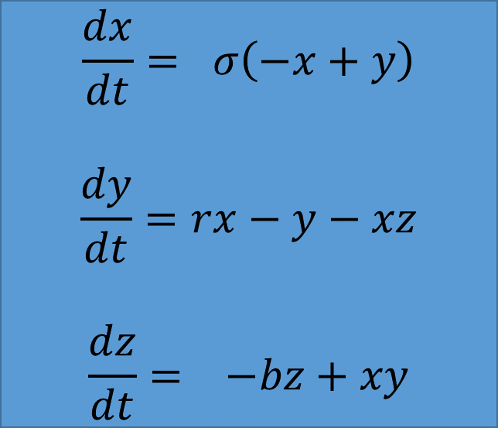
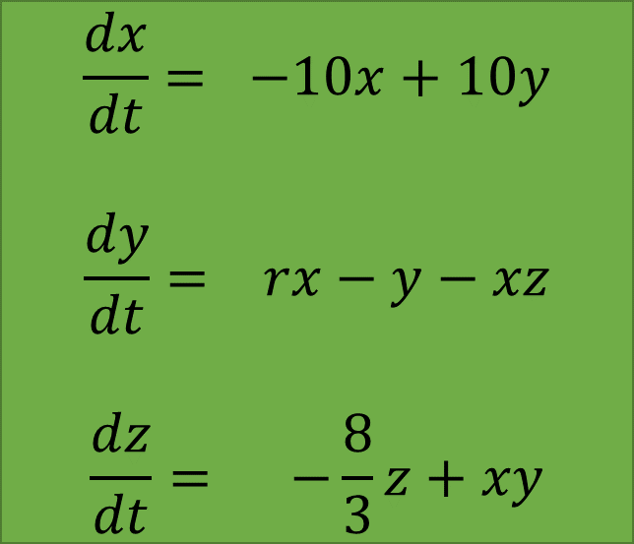
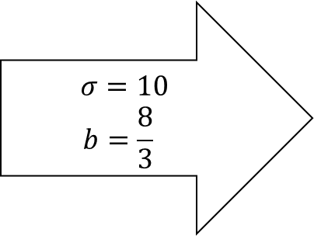
Lorenz Equation on Earth
For the Earth’s atmosphere, reasonable values of the parameters are $σ=10$ and $b=\frac{8}{3}$
$$\frac{dx}{dt}= σ\left(−x+y\right)$$
$$\frac{dy}{dt}=rx−y−xz$$
$$\frac{dz}{dt}= −bz+xy$$
$$\frac{dx}{dt}= −10x+10y$$
$$\frac{dy}{dt}= rx−y−xz$$
$$\frac{dz}{dt}= −\frac{8}{3}z+xy$$
$$σ=10$$
$$b=\frac{8}{3}$$

Slide 23
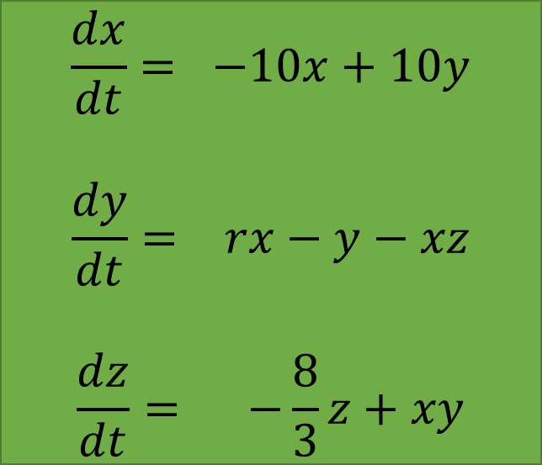
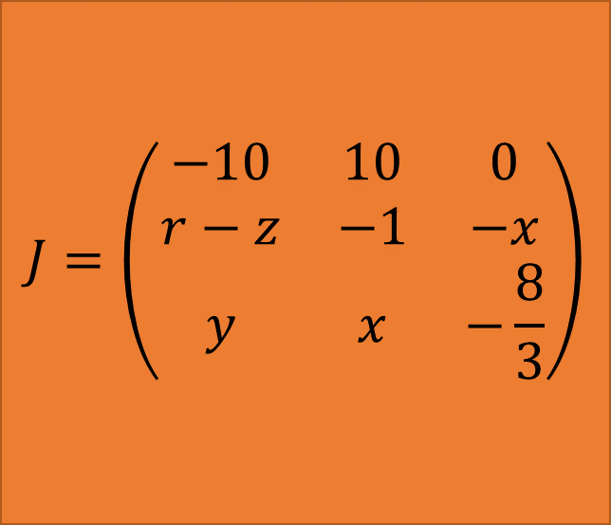
Lorenz Equation on Earth
$$\frac{dx}{dt}= −10x+10y$$
$$\frac{dy}{dt}= rx−y−xz$$
$$\frac{dz}{dt}= −\frac{8}{3}z+xy$$
$$J=\left(\begin{matrix}−10 & 10 & 0 \\ r−z & −1 & −x \\ y & x & −\frac{8}{3}\end{matrix}\right)$$

Slide 24
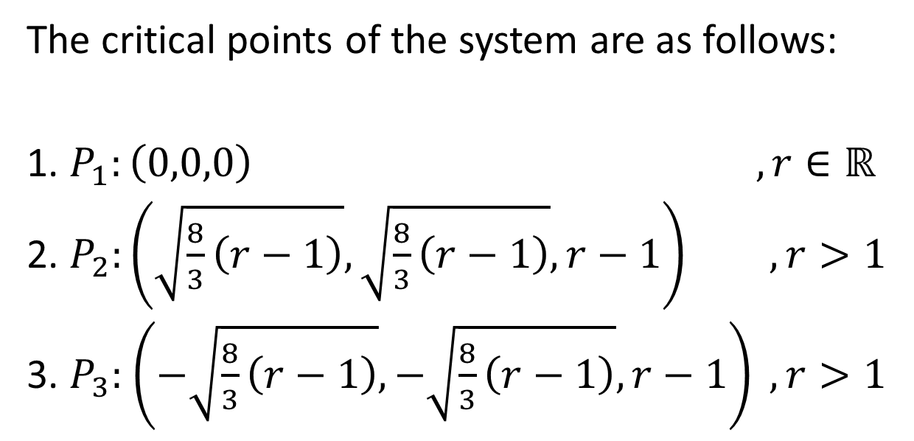
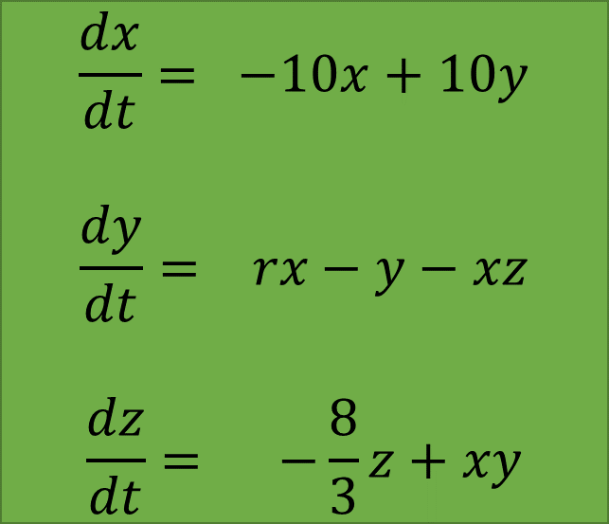

Lorenz Equation on Earth
$$\frac{dx}{dt}= −10x+10y$$
$$\frac{dy}{dt}= rx−y−xz$$
$$\frac{dz}{dt}= −\frac{8}{3}z+xy$$
The critical points of the system are as follows:
1. $P_{1}:\left(0,0,0\right)$ $,r∈ℝ$
2. $P_{2}:\left(\sqrt{\frac{8}{3}\left(r−1\right)},\sqrt{\frac{8}{3}\left(r−1\right)},r−1\right) , r>1$
3. $P_{3}:$ $\left(−\sqrt{\frac{8}{3}\left(r−1\right)},−\sqrt{\frac{8}{3}\left(r−1\right)},r−1\right) , r>1$
$$J=\left(\begin{matrix}−10 & 10 & 0 \\ r−z & −1 & −x \\ y & x & −\frac{8}{3}\end{matrix}\right)$$

Slide 25
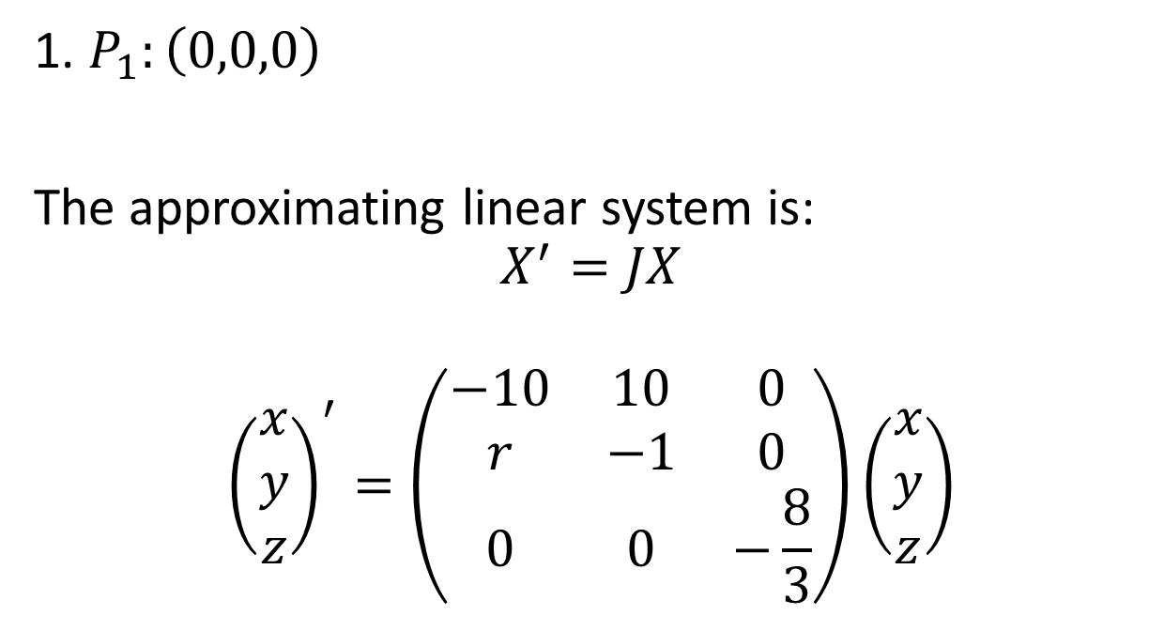
Lorenz Equation on Earth
$$\frac{dx}{dt}= −10x+10y$$
$$\frac{dy}{dt}= rx−y−xz$$
$$\frac{dz}{dt}= −\frac{8}{3}z+xy$$
1. $P_{1}:\left(0,0,0\right)$
The approximating linear system is:
$$X^{′}=JX$$
$${\left(\begin{matrix}x \\ y \\ z\end{matrix}\right)}^{′}=\left(\begin{matrix}−10 & 10 & 0 \\ r & −1 & 0 \\ 0 & 0 & −\frac{8}{3}\end{matrix}\right)\left(\begin{matrix}x \\ y \\ z\end{matrix}\right)$$
$$J=\left(\begin{matrix}−10 & 10 & 0 \\ r−z & −1 & −x \\ y & x & −\frac{8}{3}\end{matrix}\right)$$

Slide 26
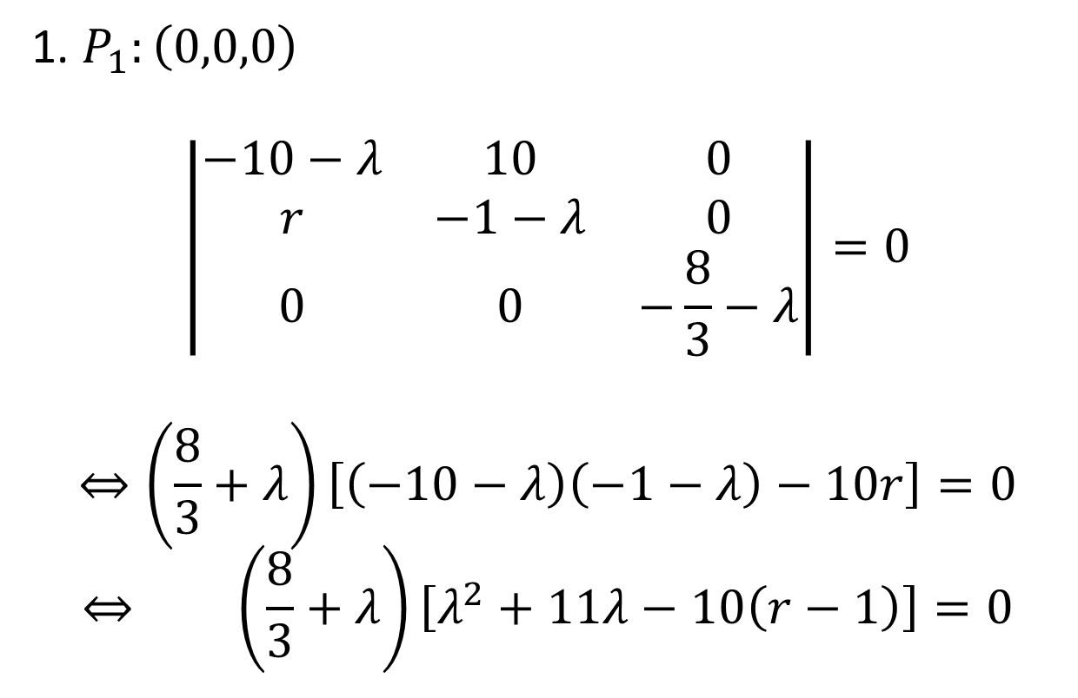

Lorenz Equation on Earth
$$\frac{dx}{dt}= −10x+10y$$
$$\frac{dy}{dt}= rx−y−xz$$
$$\frac{dz}{dt}= −\frac{8}{3}z+xy$$
1. $P_{1}:\left(0,0,0\right)$
$$\left|\begin{matrix}−10−λ & 10 & 0 \\ r & −1−λ & 0 \\ 0 & 0 & −\frac{8}{3}−λ\end{matrix}\right|=0$$
$$⇔\left(\frac{8}{3}+λ\right)\left[\left(−10−λ\right)\left(−1−λ\right)−10r\right]=0$$
$$⇔ \left(\frac{8}{3}+λ\right)\left[λ^{2}+11λ−10\left(r−1\right)\right]=0$$
$$J=\left(\begin{matrix}−10 & 10 & 0 \\ r & −1 & 0 \\ 0 & 0 & −\frac{8}{3}\end{matrix}\right)$$

Slide 27

Lorenz Equation on Earth
$$\frac{dx}{dt}= −10x+10y$$
$$\frac{dy}{dt}= rx−y−xz$$
$$\frac{dz}{dt}= −\frac{8}{3}z+xy$$
1. $P_{1}:\left(0,0,0\right)$
The Characteristic Equation is given by:
$$\left(\frac{8}{3}+λ\right)\left[λ^{2}+11λ−10\left(r−1\right)\right]=0$$
Solving these for $λ$, we have:
$$λ_{1}=−\frac{8}{3}, λ_{2,3}=\frac{−11±\sqrt{81+40r}}{2}$$
$$J=\left(\begin{matrix}−10 & 10 & 0 \\ r & −1 & 0 \\ 0 & 0 & −\frac{8}{3}\end{matrix}\right)$$

Slide 28

Lorenz Equation on Earth
$$\frac{dx}{dt}= −10x+10y$$
$$\frac{dy}{dt}= rx−y−xz$$
$$\frac{dz}{dt}= −\frac{8}{3}z+xy$$
1. $P_{1}:\left(0,0,0\right)$
$λ_{1}=−\frac{8}{3}$, $λ_{2}=\frac{−11−\sqrt{81+40r}}{2}$, $λ_{3}=\frac{−11+\sqrt{81+40r}}{2}$
If $r∈\left(0,1\right)$, then:
$$\operatorname{sgn}\left(λ_{1}\right)=\operatorname{sgn}\left(λ_{2}\right)=\operatorname{sgn}\left(λ_{3}\right)=−1$$
Else if $r=1$, then:
$$\operatorname{sgn}\left(λ_{1}\right)=\operatorname{sgn}\left(λ_{2}\right)=−1,\operatorname{sgn}\left(λ_{3}\right)=0$$
Else if $r∈\left(1, ∞\right)$, then:
$$\operatorname{sgn}\left(λ_{1}\right)=\operatorname{sgn}\left(λ_{2}\right)=−1,\operatorname{sgn}\left(λ_{3}\right)=1$$
$$J=\left(\begin{matrix}−10 & 10 & 0 \\ r & −1 & 0 \\ 0 & 0 & −\frac{8}{3}\end{matrix}\right)$$

Slide 29

Lorenz Equation on Earth
$$\frac{dx}{dt}= −10x+10y$$
$$\frac{dy}{dt}= rx−y−xz$$
$$\frac{dz}{dt}= −\frac{8}{3}z+xy$$
2. $P_{2}:\left(\sqrt{\frac{8}{3}\left(r−1\right)},\sqrt{\frac{8}{3}\left(r−1\right)},r−1\right)$
The approximating linear system is:
$$X^{′}=JX$$
$${\left(\begin{matrix}u \\ v \\ w\end{matrix}\right)}^{′}=\left(\begin{matrix}−10 & 10 & 0 \\ 1 & −1 & −\sqrt{\frac{8}{3}\left(r−1\right)} \\ \sqrt{\frac{8}{3}\left(r−1\right)} & \sqrt{\frac{8}{3}\left(r−1\right)} & −\frac{8}{3}\end{matrix}\right)\left(\begin{matrix}u \\ v \\ w\end{matrix}\right)$$
$$J=\left(\begin{matrix}−10 & 10 & 0 \\ r−z & −1 & −x \\ y & x & −\frac{8}{3}\end{matrix}\right)$$

Slide 30


Lorenz Equation on Earth
$$\frac{dx}{dt}= −10x+10y$$
$$\frac{dy}{dt}= rx−y−xz$$
$$\frac{dz}{dt}= −\frac{8}{3}z+xy$$
2. $P_{2}:\left(\sqrt{\frac{8}{3}\left(r−1\right)},\sqrt{\frac{8}{3}\left(r−1\right)},r−1\right)$
The Characteristic Equation is given by:
$$\left|\begin{matrix}−10−λ & 10 & 0 \\ 1 & −1−λ & −\sqrt{\frac{8}{3}\left(r−1\right)} \\ \sqrt{\frac{8}{3}\left(r−1\right)} & \sqrt{\frac{8}{3}\left(r−1\right)} & −\frac{8}{3}−λ\end{matrix}\right|=0$$
$$\left(−10−λ\right)\left[\left(−1−λ\right)\left(−\frac{8}{3}−λ\right)+\frac{8}{3}\left(r−1\right)\right]−10\left[−\frac{8}{3}−λ+\frac{8}{3}\left(r−1\right)\right]=0$$
$$J=\left(\begin{matrix}−10 & 10 & 0 \\ 1 & −1 & −\sqrt{\frac{8}{3}\left(r−1\right)} \\ \sqrt{\frac{8}{3}\left(r−1\right)} & \sqrt{\frac{8}{3}\left(r−1\right)} & −\frac{8}{3}\end{matrix}\right)$$

Slide 31

Lorenz Equation on Earth
$$\frac{dx}{dt}= −10x+10y$$
$$\frac{dy}{dt}= rx−y−xz$$
$$\frac{dz}{dt}= −\frac{8}{3}z+xy$$
2. $P_{2}:\left(\sqrt{\frac{8}{3}\left(r−1\right)},\sqrt{\frac{8}{3}\left(r−1\right)},r−1\right)$
$$\left(−10−λ\right)\left[\left(−1−λ\right)\left(−\frac{8}{3}−λ\right)+\frac{8}{3}\left(r−1\right)\right]−10\left[−\frac{8}{3}−λ+\frac{8}{3}\left(r−1\right)\right]=0$$
$$⇔\left(−10−λ\right)\left[\frac{8}{3}+\frac{11}{3}λ+λ^{2}+\frac{8}{3}\left(r−1\right)\right]+\frac{80}{3}+10λ−\frac{80}{3}\left(r−1\right)=0$$
$$⇔−\frac{80}{3}−\frac{110}{3}λ−10λ^{2}−\frac{80}{3}\left(r−1\right)+\frac{80}{3}+\frac{30}{3}λ−\frac{80}{3}\left(r−1\right)$$
$−λ\left[\frac{8}{3}+\frac{11}{3}λ+λ^{2}+\frac{8}{3}\left(r−1\right)\right]=0$
$$⇔−\frac{80}{3}λ−10λ^{2}−\frac{160}{3}\left(r−1\right)−\frac{8}{3}λ−\frac{11}{3}λ^{2}−λ^{3}−\frac{8}{3}λ\left(r−1\right)=0$$
$$J=\left(\begin{matrix}−10 & 10 & 0 \\ 1 & −1 & −\sqrt{\frac{8}{3}\left(r−1\right)} \\ \sqrt{\frac{8}{3}\left(r−1\right)} & \sqrt{\frac{8}{3}\left(r−1\right)} & −\frac{8}{3}\end{matrix}\right)$$

Slide 32

Lorenz Equation on Earth
$$\frac{dx}{dt}= −10x+10y$$
$$\frac{dy}{dt}= rx−y−xz$$
$$\frac{dz}{dt}= −\frac{8}{3}z+xy$$
2. $P_{2}:\left(\sqrt{\frac{8}{3}\left(r−1\right)},\sqrt{\frac{8}{3}\left(r−1\right)},r−1\right)$
$$⇔−\frac{80}{3}λ−10λ^{2}−\frac{160}{3}\left(r−1\right)−\frac{8}{3}λ−\frac{11}{3}λ^{2}−λ^{3}−\frac{8}{3}λ\left(r−1\right)=0$$
$$⇔80λ+30λ^{2}+160\left(r−1\right)+8λ+11λ^{2}+3λ^{3}+8λ\left(r−1\right)=0$$
$$⇔3λ^{3}+41λ^{2}+8\left(r+10\right)λ+160\left(r−1\right)=0$$
$$J=\left(\begin{matrix}−10 & 10 & 0 \\ 1 & −1 & −\sqrt{\frac{8}{3}\left(r−1\right)} \\ \sqrt{\frac{8}{3}\left(r−1\right)} & \sqrt{\frac{8}{3}\left(r−1\right)} & −\frac{8}{3}\end{matrix}\right)$$

Slide 33


Lorenz Equation on Earth
$$\frac{dx}{dt}= −10x+10y$$
$$\frac{dy}{dt}= rx−y−xz$$
$$\frac{dz}{dt}= −\frac{8}{3}z+xy$$
2. $P_{2}:\left(\sqrt{\frac{8}{3}\left(r−1\right)},\sqrt{\frac{8}{3}\left(r−1\right)},r−1\right)$
$$λ_{1}=$$
$$J=\left(\begin{matrix}−10 & 10 & 0 \\ 1 & −1 & −\sqrt{\frac{8}{3}\left(r−1\right)} \\ \sqrt{\frac{8}{3}\left(r−1\right)} & \sqrt{\frac{8}{3}\left(r−1\right)} & −\frac{8}{3}\end{matrix}\right)$$

Slide 34


Lorenz Equation on Earth
$$\frac{dx}{dt}= −10x+10y$$
$$\frac{dy}{dt}= rx−y−xz$$
$$\frac{dz}{dt}= −\frac{8}{3}z+xy$$
2. $P_{2}:\left(\sqrt{\frac{8}{3}\left(r−1\right)},\sqrt{\frac{8}{3}\left(r−1\right)},r−1\right)$
$$λ_{2,3}=$$
$$J=\left(\begin{matrix}−10 & 10 & 0 \\ 1 & −1 & −\sqrt{\frac{8}{3}\left(r−1\right)} \\ \sqrt{\frac{8}{3}\left(r−1\right)} & \sqrt{\frac{8}{3}\left(r−1\right)} & −\frac{8}{3}\end{matrix}\right)$$

Slide 35

Lorenz Equation on Earth
$$\frac{dx}{dt}= −10x+10y$$
$$\frac{dy}{dt}= rx−y−xz$$
$$\frac{dz}{dt}= −\frac{8}{3}z+xy$$
2. $P_{2}:\left(\sqrt{\frac{8}{3}\left(r−1\right)},\sqrt{\frac{8}{3}\left(r−1\right)},r−1\right)$
If $r∈\left(0,r_{1}\right):r_{1}≅1.3456$, then:
$$\operatorname{sgn}\left(λ_{1}\right)=\operatorname{sgn}\left(λ_{2}\right)=\operatorname{sgn}\left(λ_{3}\right)=−1$$
Else if $r∈\left(r_{1},r_{2}\right):r_{2}≅24.737$, then:
$$\operatorname{sgn}\left(λ_{1}\right)=sgn\left(ℜ\left(λ_{2}\right)\right)=sgn\left(ℜ\left(λ_{3}\right)\right)=−1$$
Else if $r∈\left(r_{2},∞\right)$, then:
$$\operatorname{sgn}\left(λ_{1}\right)=−1, sgn\left(ℜ\left(λ_{2}\right)\right)=sgn\left(ℜ\left(λ_{3}\right)\right)=1$$
$$J=\left(\begin{matrix}−10 & 10 & 0 \\ 1 & −1 & −\sqrt{\frac{8}{3}\left(r−1\right)} \\ \sqrt{\frac{8}{3}\left(r−1\right)} & \sqrt{\frac{8}{3}\left(r−1\right)} & −\frac{8}{3}\end{matrix}\right)$$

Slide 36

Lorenz Equation on Earth
$$\frac{dx}{dt}= −10x+10y$$
$$\frac{dy}{dt}= rx−y−xz$$
$$\frac{dz}{dt}= −\frac{8}{3}z+xy$$
3. $P_{3}:\left(−\sqrt{\frac{8}{3}\left(r−1\right)},−\sqrt{\frac{8}{3}\left(r−1\right)},r−1\right)$
The approximating linear system is:
$$X^{′}=JX$$
$${\left(\begin{matrix}a \\ b \\ c\end{matrix}\right)}^{′}=\left(\begin{matrix}−10 & 10 & 0 \\ 1 & −1 & \sqrt{\frac{8}{3}\left(r−1\right)} \\ −\sqrt{\frac{8}{3}\left(r−1\right)} & −\sqrt{\frac{8}{3}\left(r−1\right)} & −\frac{8}{3}\end{matrix}\right)\left(\begin{matrix}a \\ b \\ c\end{matrix}\right)$$
$$J=\left(\begin{matrix}−10 & 10 & 0 \\ 1 & −1 & −\sqrt{\frac{8}{3}\left(r−1\right)} \\ \sqrt{\frac{8}{3}\left(r−1\right)} & \sqrt{\frac{8}{3}\left(r−1\right)} & −\frac{8}{3}\end{matrix}\right)$$

Slide 37


Lorenz Equation on Earth
$$\frac{dx}{dt}= −10x+10y$$
$$\frac{dy}{dt}= rx−y−xz$$
$$\frac{dz}{dt}= −\frac{8}{3}z+xy$$
3. $P_{3}:\left(−\sqrt{\frac{8}{3}\left(r−1\right)},−\sqrt{\frac{8}{3}\left(r−1\right)},r−1\right)$
The Characteristic Equation is given by:
$$\left|\begin{matrix}−10−λ & 10 & 0 \\ 1 & −1−λ & \sqrt{\frac{8}{3}\left(r−1\right)} \\ −\sqrt{\frac{8}{3}\left(r−1\right)} & −\sqrt{\frac{8}{3}\left(r−1\right)} & −\frac{8}{3}−λ\end{matrix}\right|=0$$
$$\left(−10−λ\right)\left[\left(−1−λ\right)\left(−\frac{8}{3}−λ\right)+\frac{8}{3}\left(r−1\right)\right]−10\left[−\frac{8}{3}−λ+\frac{8}{3}\left(r−1\right)\right]=0$$
$$J=\left(\begin{matrix}−10 & 10 & 0 \\ 1 & −1 & \sqrt{\frac{8}{3}\left(r−1\right)} \\ −\sqrt{\frac{8}{3}\left(r−1\right)} & −\sqrt{\frac{8}{3}\left(r−1\right)} & −\frac{8}{3}\end{matrix}\right)$$

Slide 38


Lorenz Equation on Earth
Thus, we can summarize this system to:
For $r∈\left(0, 1\right)$,
The only critical point is $P_{1}$ and is asymptotically stable
For $r∈\left(1,r_{1}\right):$ $r_{1}≅1.3456$,
The critical point $P_{1}$ is unstable, while the critical points $P_{2}, P_{3}$ is asymptotically stable
For $r∈\left(r_{1},r_{2}\right):r_{2}≅24.737$,
The critical point $P_{1}$ is unstable, while the critical points $P_{2}, P_{3}$ is asymptotically stable
For $r∈\left(r_{2},∞\right)$,
All the critical points $P_{1},P_{2},P_{3}$ are unstable
$$\frac{dx}{dt}= −10x+10y$$
$$\frac{dy}{dt}= rx−y−xz$$
$$\frac{dz}{dt}= −\frac{8}{3}z+xy$$

Slide 39



Plot of the Lorentz Equation
$$\left(σ=10, b=\frac{8}{3},r=28,Init=\left[0.1,0,0\right]\right)$$

Slide 40

Plot of the Lorentz Equation
$$\left(σ=10, b=\frac{8}{3},r=28,Init=\left[0.1,0,0\right]\right)$$

Slide 41

Plot of the Lorentz Equation
$$\left(σ=10, b=\frac{8}{3},r=28,Init=\left[0.1,0,0\right]\right)$$

Slide 42
References
William E. Boyce & Richard C. DiPrima. 2012. Elementary Differential Equations and Boundary Value Problems. Massachusetts. John Wiley & Sons, Inc.
Boeing, Geoff. 2016. Animating the Lorenz Attractor with Python.
http://geoffboeing.com/2016/12/animating-lorenz-attractor-python/
Diakses pada 22 November 2017 pukul 10.33 WIB
Hateley, James C. n.d. The Lorenz System.
http://web.math.ucsb.edu/~jhateley/paper/lorenz.pdf
Diakses pada 23 November 2017 pukul 07.22 WIB
Weisstein, Eric W. n.d. Lorenz Attractor.
http://mathworld.wolfram.com/LorenzAttractor.html
Diakses pada 22 November 2017 pukul 10.26 WIB

Slide 43




Softwares Used

Slide 44
Any Questions?

